Slide 1
DATABASE MANAGEMENT SYSTEMS
Subject Teacher: Junaid Javed Korai
1

Slide 2
DATA AND DATABASE
Lecture # 1 & 2
Disclaimer: The material used in this presentation to deliver the lecture i.e., definitions/text and pictures/graphs etc. does not solely belong to the author/presenter. The presenter has gathered this lecture material from various sources on web/textbooks. Following sources are especially acknowledged:
Connolly, Thomas M., and Carolyn E. Begg. Database systems: a practical approach to design, implementation, and management. Pearson Education, 2005.
2. Hoffer, Jeffrey A., Venkataraman Ramesh, and Heikki Topi. Modern database management. Upper Saddle River, NJ: Prentice Hall,, 2011.
2

Slide 3
IN THIS LECTURE YOU WILL LEARN ABOUT:
Data, Information, Metadata
Traditional File Processing System
Examples of Database Systems
Database
Database Management Systems
Database application programs,Views
Database environment
Functions of a DBMS
Advantages and Disadvantages of DBMS

Slide 4
DATA
Data is a plural form of datum, which means a piece of information.
Data is a collection of facts & figures, such as values or
measurements.
Data can be,
  Numbers
  Words
  Measurements
A collection of data which conveys some meaningful idea is called information.

Slide 5
DATA (CONT’D)
Another definition of data can be a representations of objects and events that have meaning and importance in the user’s environment and stored on computer media.
For example, in a salesperson’s database, the data would includes facts
such as customer name, address and telephone number.
This type of data is called Structured Data.
The most important structured data types are numeric, character and
dates.
Structured data are stored in tabular form (in tables, relations, arrays, spreadsheets, etc) and are most commonly found in traditional databases.

Slide 6
DATA (CONT’D)
Today’s databases are used to store objects such as documents, maps, photographic images, sound and video segment in addition to structured data.
For example, the salesperson’s database might include a photo image of the customer contact. It might also include a sound recording or video clip about the most recent product. This type of data is referred to as Unstructured Data, or as Multimedia Data.
Multimedia data are most often found on Web servers and on Web-
enabled databases.

Slide 7
INFORMATION & METADATA
Information is a data that have been processed in such a way as to increase the knowledge of the person. OR
Information is facts about situation, person, event, etc.
When data is collated or organized into meaningful form, it gains
significance, and that meaningful data is called information.
Metadata is a data about data.
Metadata is data that describe the properties or characteristics of end- user data, and the context of that data. Some of the properties that are typically described include data names, definitions, size and allowable values.
For example if ID is a data then the ID must have data type.

Slide 8
DATA VS INFORMATION
The terms data and information are closely related and in fact are often used interchangeably.
However, it is useful to distinguish between data and information.
For example
  221120 is a data;
  it can be information if 22/11/20 date of your exam.
  221120 can be a zip code of any city.
  PKR 221,120 can be Salary of any Person

Slide 9
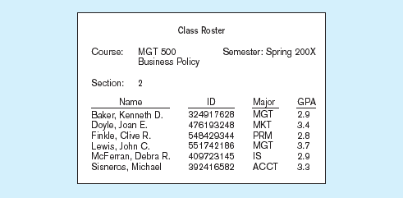
Data in context

Slide 10
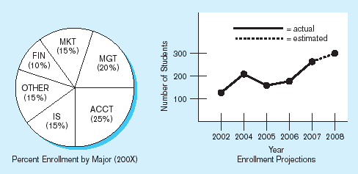
Summarized data
Graphical displays turn data into useful information that managers can use for 10
decision making and interpretation

Slide 11
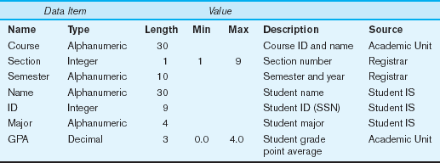
Descriptions of the properties or characteristics of the data, including data types, field sizes, allowable values, and data context
11

Slide 12
TRADITIONAL FILE PROCESSING SYSTEM
T
Traditional file processing system or simple file processing system refers to the first computer-based approach of handling the commercial or business applications.
That is why it is also called a replacement of the manual file system.
While computers were introduced into the business world there is no any concept of DBMS, therefore computer file processing systems were developed to store, maintain and retrieve large files of data.
In Traditional File Processing System each application is designed with its own set of data files.
12

Slide 13
TRADITIONAL FILE PROCESSING SYSTEM
The data may already be present in files for other applications but would need to be restructured to meet the needs of the new application.When a new application is required it is simpler to develop new file structures along with the new application.
Different application programs are written to extract data from these files and to add record to these files.
But,There are Number of disadvantages in using File Processing System, to store the data.
13

Slide 14
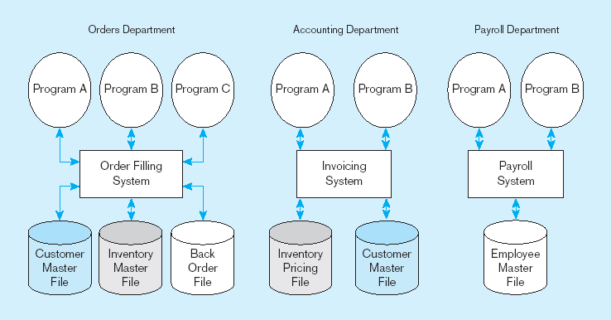
Duplicate Data
Traditional File Processing System
14

Slide 15
DISADVANTAGES OF TRADITIONAL FILE PROCESSING SYSTEM
Program-Data Dependence, The reports produced by the file processing system are program dependent, which means if any change in the format or structure of data and records in the file is to be made, the programs have to modified correspondingly. Also, a new program will have to be developed to produce a new report.
Duplication of Data, Since each application has its own data file, the same data may have to be recorded and stored in many files. For example, personal file and payroll file, both contain data on employee name, designation etc. The result is unnecessary duplicate or redundant data items.
15

Slide 16
DISADVANTAGES OF TRADITIONAL FILE PROCESSING SYSTEM
Limited Data Sharing, There is limited data sharing possibilities with the traditional file system. Each application has its own private files and users have little choice to share the data outside their own applications.
Lengthy Development Times, each new application requires that the developer essentially start from scratch by designing new file formats and descriptions and then writing the file access logic for each new program.
Excessive Program Maintenance, all above factors combined to create a
heavy program maintenance load in organization.
16

Slide 17
PROBLEMS WITH DATA DEPENDENCY
Each application programmer must maintain his/her own data
Each application program needs to include code for the metadata of each file
Each application program must have its own processing
routines for reading, inserting, updating, and deleting data
Lack of coordination and central control
Non-standard file formats
17

Slide 18





























PROBLEMS WITH DATA REDUNDANCY
Waste of space to have duplicate data
Causes more maintenance headaches
The biggest problem:
  Data changes in one file could cause inconsistencies
  Compromises in data integrity
18

Slide 19




SOLUTION:THE DATABASE APPROACH
Central repository of shared data
Data is managed by a controlling agent
Stored in a standardized, convenient form
Requires a Database Management System (DBMS)
19

Slide 20
EXAMPLES OF DATABASE SYSTEMS
Purchases from the supermarket
Purchases using your credit card
Booking a holiday at the travel agents
Using the local library
Renting a video
Using the Internet

Slide 21
DATABASE
Shared collection of logically related data (and a description of this data), designed to meet the information needs of an organization.

Slide 22
DATABASE
Shared collection – can be used simultaneously by many departments and users.
Logically related - comprises the important objects and the relationships between these objects.
Description of the data – the system catalog (meta-data) provides description of data to enable data independence.

Slide 23
DATABASE
In computing, databases are sometimes classified according to their organizational approach.
  The most prevalent approach is the Relational Database, a tabular database in which data is defined so that it can be reorganized and accessed in a number of different ways.
  A Distributed Database is one that can be dispersed or replicated among different points in a network.
  An Object-Oriented Database is one that is congruent with
the data defined in object classes and subclasses.

Slide 24
DATABASE MANAGEMENT SYSTEMS
A software system that enables users to define, create, and maintain the database and that provides controlled access to this database.

Slide 25
A software system that is used to create, maintain, and provide controlled access to user databases
DATABASE MANAGEMENT SYSTEMS
Order Filing System
Invoicing System
DBMS
Central database
Contains employee, order, inventory, pricing, and customer data
Payroll System
DBMS manages data resources like an operating system manages hardware resources

Slide 26
DATABASE APPLICATION PROGRAM
A software program that interacts with the database by issuing an appropriate request (typically an SQL statement) to the DBMS.

Slide 27
VIEWS
Allows each user to have his or her own view of the database.
A view is essentially some subset of the database.

Slide 28
VIEWS
Benefits include:
  Provide a level of security;
  Provide a mechanism to customize the appearance of the database;
  Present a consistent, unchanging picture of the structure of the database, even if the underlying database is changed.

Slide 29
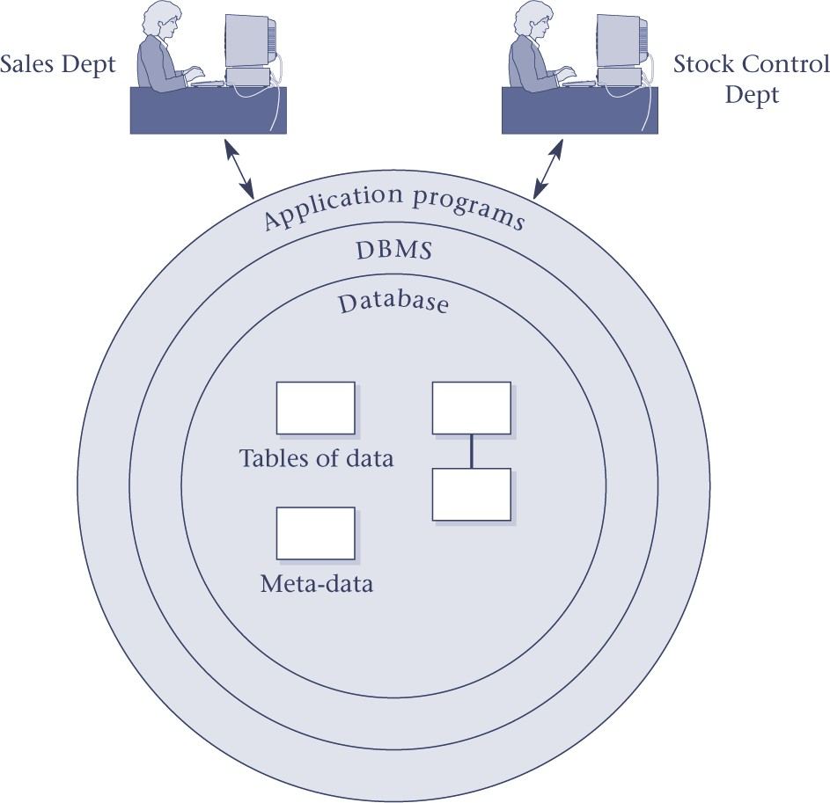
DBMS

Slide 30
COMPONENTS OF DBMS ENVIRONMENT
CASE Tools–computer-aided software engineering
Repository–centralized storehouse of metadata
Database Management System (DBMS) –software for managing the database
Database–storehouse of the data
Application Programs–software using the data
User Interface–text and graphical displays to users
Data/Database Administrators–personnel responsible for maintaining the database
System Developers–personnel responsible for designing databases and
software
End Users–people who use the applications and databases

Slide 31
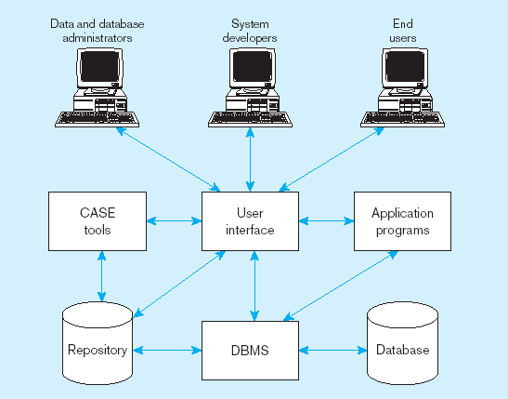
Components of the Database Environment
31

Slide 32
FUNCTIONS OF A DBMS
Data Storage, Retrieval, and Update.
A User-Accessible Catalog.
Transaction Support.
Concurrency Control Services.
Recovery Services.

Slide 33
FUNCTIONS OF A DBMS
Authorization Services.
Support for Data Communication.
Integrity Services.
Services to Promote Data Independence.
Utility Services.

Slide 34
ADVANTAGES OF DBMSS
Control of data redundancy
Data consistency
Sharing of data
Improved data integrity
Improved maintenance through data independence.

Slide 35
DISADVANTAGES OF DBMSS
Complexity
Cost of DBMS
Cost of conversion
Performance
Higher impact of a failure

